Slide 1

Wolves in Europe
By Kristen Bashen, Megan Galenski, Deandre Gutierrez, Adam Orlando, Jennifer Phelan, Alex Zamojski

Slide 2
Hypothesis
The higher wolf population in Europe is caused by less private land ownership and positive societal perceptions.

Slide 3
Attitudes Toward Wolves in Europe
19th and 20th century:
Predators were systematically eradicated to prevent livestock predation
Today:
Increased conservation efforts to protect the species and their habitats in almost every surrounding country
Wolves are not as much seen as a threat to the public
Legislation implemented to help preserve populations
Still conflicting interests between farmers due to increased cost of adding protective measures
Feared by the public
Legislation put in place supporting wolf hunting
(WWF. n.d.)

Slide 4
Attitudes Toward Wolves in the U.S.
Before and During the 20th Century:
Public feared wolves based on second-hand accounts
Today:
The ideas of wildlife preservation have increased
Endangered Species Act has recognized wolves as a protected animal on public and private land
Reintroduction of wolves have become popular in national parks and has support from the public majority
Farmers and rancher perspectives are now mixed
Thought that wolves threatened their wild game supply
Wolf extermination campaigns extended to federal wilderness areas
By the 1930s all wolves were exterminated in every U.S. national park
(Colorado State, n.d.)

Slide 5
Wolf Population Recovery in Europe
Thousands were killed per year, with large bounties being offered by many different governments
In 1973, the IUCN Wolf Specialist Conference stated there only 11 European countries left with viable breeding populations
Today there are wolf populations in 28 European countries, and an estimated 17,000 individuals
(Pimlott 1973), (Karamanlidis 2015)

Slide 6
Wolf Population Recovery in Europe
The Bern Convention of 1982 was one of the first agreements to protect wolves internationally, imposing regulations on any exploitation
In 1992, many European nations signed the Habitats Directive, which declared sites of community importance must be managed in accordance with the “ecological needs” of the species.
The enactment of these legislative policies, protecting both wolves and their habitats, have been a greatly successful factor in recovery throughout Europe so far
Currently, management plans differ throughout each nation, with many continuing to impose a complete ban on killing
(Oliver 2020), (European Commission 1992)

Slide 7
Challenges With Recovery In The US
Not all areas that are viable for wolves are used in the US (correct prey, climate conditions, etc.) due to private land ownership conflicts and human activity.
Wolves compete for livestock with humans; farmers and other private landowners kill wolves in self interest (protecting animals on their land, access to pelts for income).
Culture in the US since it’s conception has been negative; several mass attempts to cull different predator populations.
Europeans who colonized the US saw the animal populations as more expendable than in Europe, leading to a culture of over-hunting.

Slide 8
Challenges With Recovery In The US
Under the Endangered Species Act, recovery is focused on “viable” populations.
Small populations of wolves are considered “inconsequential”; their actual contribution to their population recovery is viewed as unimportant because smaller populations are not as long-term sustainable.
Americans really only want to protect self-sustaining populations.
Populations with too few females or males are usually disregarded, left to fend for themselves in terms of recovery; migrating wolf packs may branch off into several smaller packs, thus becoming “unviable” in new territory.
(Licht et al. 2010), (Chamberlain et al. 2013), (Salvatori et al. 2005)

Slide 9
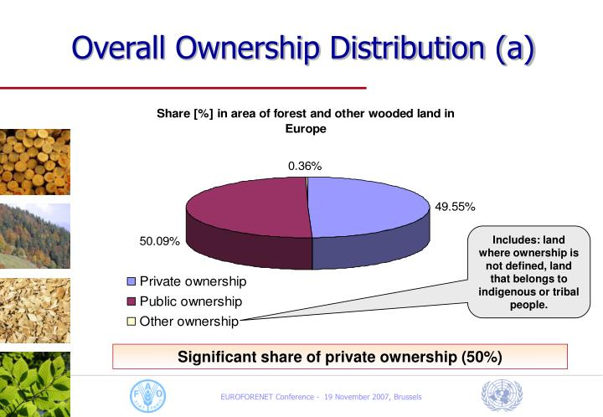
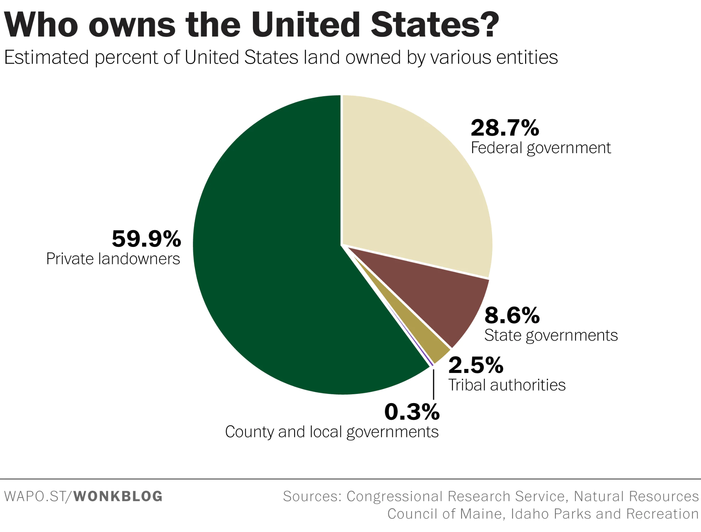
Private Land Ownership
Europe
United States
(Kerry et al. 2014)
Notes:
We took a look at the percentages of private and public land ownership within Europe, compared to the U.S to see how this may be affecting wolf movement. As you can see, Europe has about a 50/50 split between private and public land ownership while the U.S. has approximately 60% of private land ownership.

Slide 10
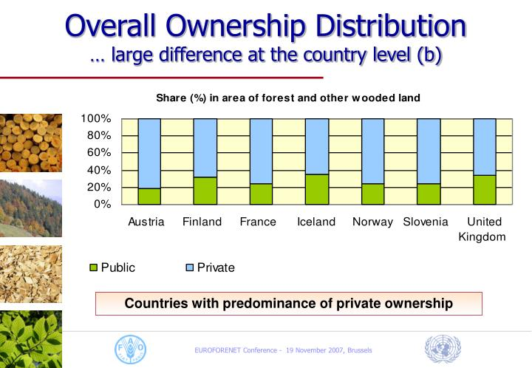
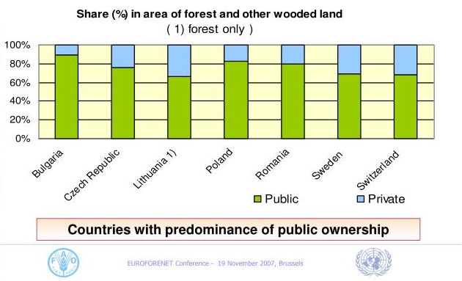
Europe
(Kerry et al. 2014)
Notes:
When we take a closer look at some countries in Europe: Austria, Finland, France, Iceland, Norway, Slovenia, and the UK were countries with a predominance of private land ownership, all of them less than 40%. While Bulgaria, Poland, Romania, Sweden, Switzerland, Lithuania, and the Czech Republic have over 70% of public ownership.

Slide 11
Impacts of Land Ownership on Wolves
In countries with less private land ownership like Poland, Romania, and Sweden, wolf populations have increased within the last decade
We can hypothesize that in countries with higher private land ownership, wolves may be hunted or poached illegally and without documentation
Along with opinions from wildlife ecologist and postdoc Ophelie Couriot, we can infer that the type of land ownership can have an impact on wolf populations and wolves in Europe are more accustomed to human interactions
(O. Couriot pers. comm. 2022)

Slide 12
Age of Coexistence
In Europe, wolves are highly protected under current legislation along with the EU environmental policies.
Duration of EU membership, current management practices, and history of coexistence are all factors which shape how wolves and humans are able to coexist now.
In areas with high human and wolf populations, predation on livestock can galvanize a negative public opinion on wolves.
Public Perceptions:
“Do you think wolves should be legally protected?” [72%-84% Agree]
“Do you think that these animals should be actively kept out of your local region?” [65%-77% Disagree]
(Grossmann et al. 2020)

Slide 13
Age of Coexistence
What needs to be done?
Decrease physical, environmental, and cultural borders which limit movement.
Increase international involvement and cooperation for wolf management.
Increase public awareness and knowledge on the value of having a more natural ecosystem that includes large predators.
Increase monitoring and management efforts in difficult regions where wolf populations are often highest.
Notes:
Hypothesis: The higher wolf population in Europe is caused by less private land ownership and positive societal perceptions.

Slide 14
Sources
Fogleman, V. M. 1989. American Attitudes Towards Wolves: A History of Misperception. Environmental Review: ER 13:63–94.
W., M. J. Chamberlain, and D. R. Rabon. 2013. Red Wolf (Canis rufus) Recovery: A Review with Suggestions for Future Research. Animals 3:722–744.
Salvatori, V., and J. Linnell. 2005. Report on the Conservation Status and Threats for Wolf (Canis lupus) in Europe.5
Couriot, O. December 1, 2022. Email interview
Grossmann, C. M., L. Patkó, D. Ortseifen, E. Kimmig, E.-M. Cattoen, and U. Schraml. 2020. Human-large carnivores co-existence in Europe – a comparative stakeholder network analysis. Frontiers in Ecology and Evolution 8.
Licht, D. S., J. J. Millspaugh, K. E. Kunkel, C. O. Kochanny, and R. O. Peterson. 2010. Using Small Populations of Wolves for Ecosystem Restoration and Stewardship. BioScience 60:147–153.
Public Perspectives on Wolves and Wolf Reintroduction - 8.004. (n.d.). . https://extension.colostate.edu/topic-areas/people-predators/public-perspectives-on-wolves-and-wolf-reintroduction-8-004/.
The return of the wolf in Europe. (n.d.). . https://www.worldwildlife.org/stories/the-return-of-the-wolf-in-europe.
Kerry. 2014, August 22. Private Forest Ownership and Wood Mobilization in Europe. https://www.slideserve.com/kerry/private-forest-ownership-and-wood-mobilization-in-europe.
European Commission. (1992). The Habitats Directive. The Habitats Directive - Environment - European Commission. Retrieved December 5, 2022, from https://ec.europa.eu/environment/nature/legislation/habitatsdirective/index_en.htm
Karamanlidis, A. (2015). The Wolf in Europe. Rewilding Europe. Retrieved December 5, 2022, from https://rewildingeurope.com/rewilding-in-action/wildlife-comeback/wolf/#:~:text=In%20total%2C%20the%20grey%20wolf,European%20Russia)%20in%2028%20countries.
Oliver, K. (2020). Bern Convention - Appendix 1, Appendix 2 and Appendix 3 Combined. NBN Atlas. Retrieved December 5, 2022, from https://registry.nbnatlas.org/public/show/dr2400
Pimlott, D. (1973). Proceedings of the First Working Meeting of Wolf Specialists and of the First International Conference on Conservation of the Wolf. IUCN PUBLICATIONS NEW SERIES. Retrieved December 6, 2022, from https://portals.iucn.org/library/sites/library/files/documents/NS-SP-043.pdf

Slide 15
Questions?

